Slide 1


Slide 2
BIETIANS(ECE)
ROAD ACCIDENT SAFETY SYSTEM

Slide 3
PROBLEM STATEMENT
ALERTING HOSPITALS AND POLICE REGARDING THE ACCIDENT .
SHARING ALL THE DETAILS OF THE VICTIM TO NEARBY HOSPITALS.
WE CAN SEND LOCATION ,SPEED,DETAILS OF THE ACCIDENT.
TRYING MAXIMUM TO AVOID THE ACCIDENT FIRST USING SENSORS AND CONNECTING THEM TO ABS AND AIR BAGS.
THE FINAL IDEA IS TO AVOID ACCIDENTS AND SAVE LIVES AS EARLY AS POSSIBLE IN REMOTE AREAS OR ANY NIGHT OR EARLY MORNING SITUATIONS.

Slide 4
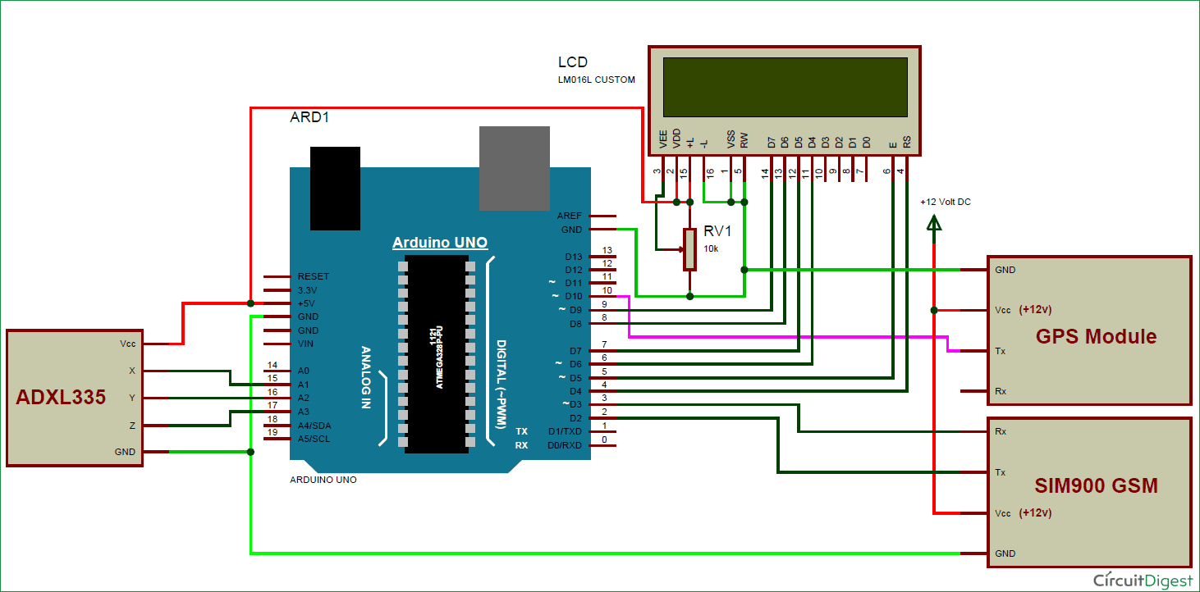
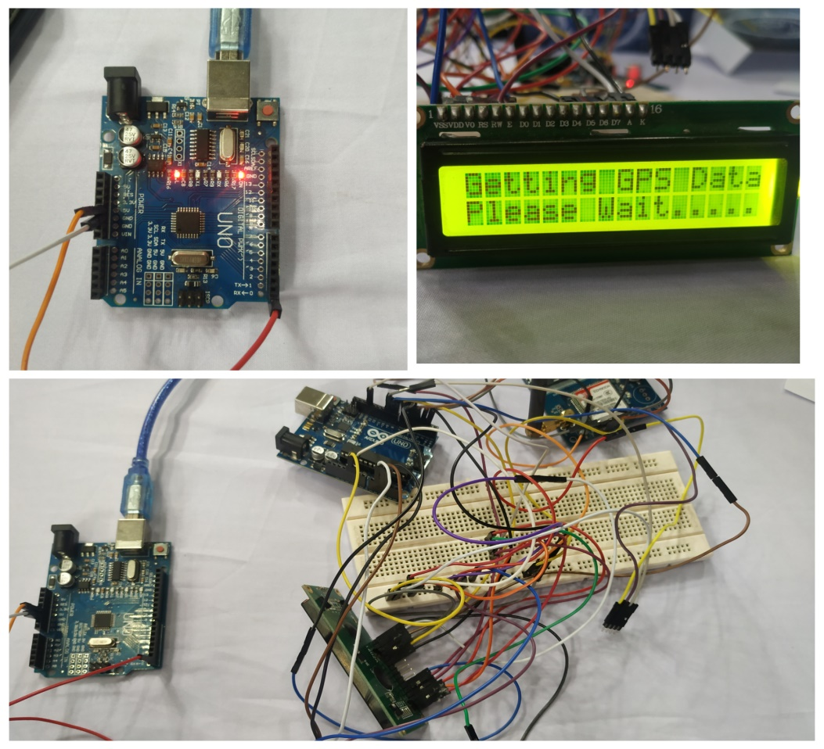

Slide 5
EXISTING SOLUTIONS
AIR BAGS.
INFORMATION THROUGH NEAR BY PEOPLE.
ABS(AUTOMATIC BREAKING SYSTEM).
FLIPPING CONTROLLERS IN HIGH-END CARS.

Slide 6
Team
HARSHA VARDHAN
HARSHINI
SOWMYA SRI
M ANOOP

